Slide 1
Have SDA’s Misunderstood the Sanctuary?
By Robert Melashenko

Slide 2
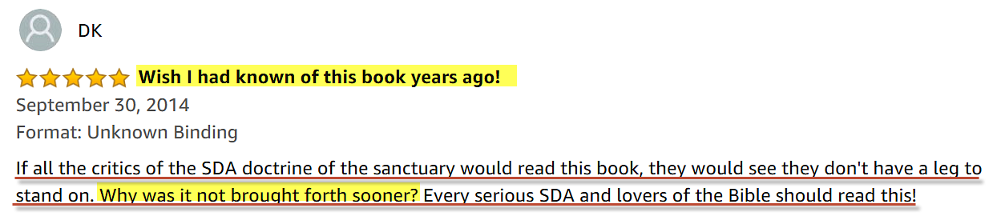

Would this review interest you?

Slide 3
The heart is deceitful above all things, and desperately wicked: who can know it?
(Jer 17:9)

Slide 4
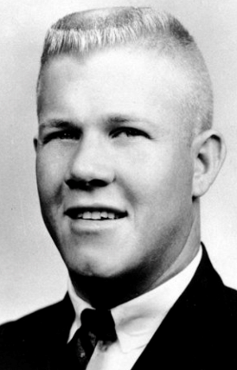
Thought Experiment

Slide 5
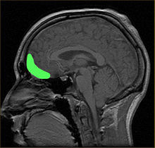

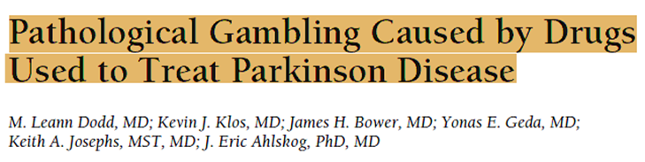
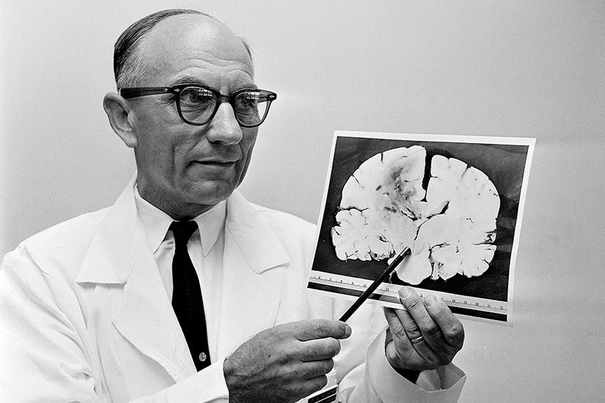
The Answers

Slide 6
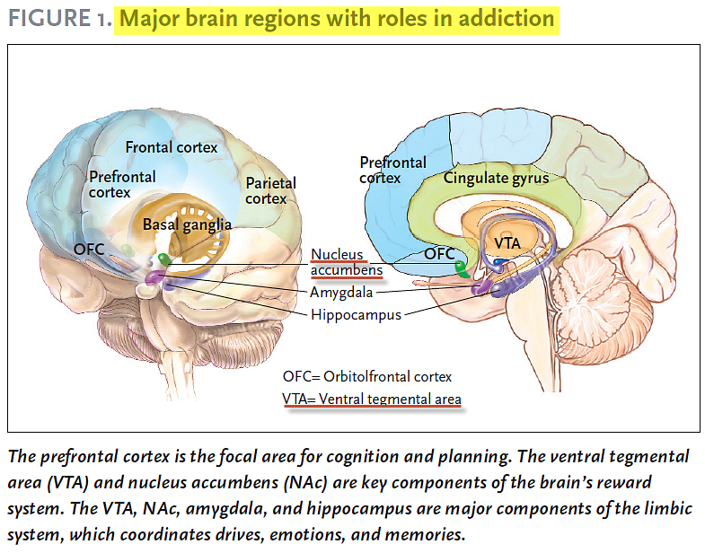
SCIENCE & PRACTICE PERSPECTIVES — APRIL 2007

Slide 7
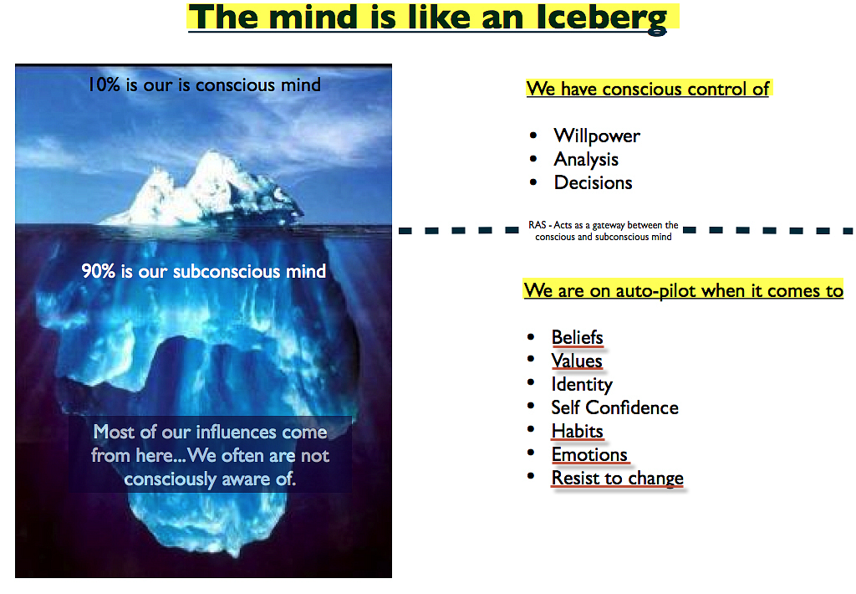

Slide 8
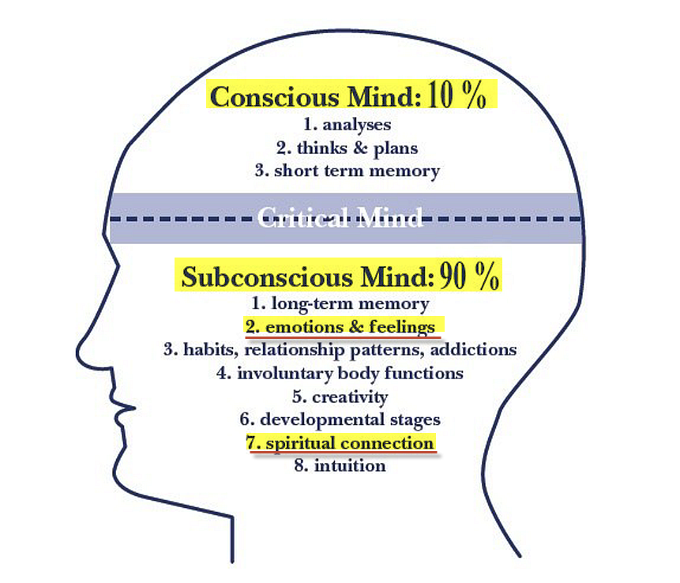
The Subconscious Mind

Slide 9
THE TREE OF KNOWLEDGE OF GOOD AND EVIL

Slide 10
Seeing then that the unconscious processes play so large a part in our mental life and in our conduct, and realizing that so much evil lies in the depths, theologians have very naturally asked how far redemptive processes as preached in the Gospel of Christ can affect the unconscious. Does the acceptance of modern psychological theories lead to the conclusion that religious life is concerned only with the conscious mind, and that a very large part of human personality is left untouched and unchanged? Are we also to infer that the Christian must remain in a state where much of his being is in rebellion against God, or is alien to God?
Ernest White, Christian Life and the Unconscious, New York, 1955, p. 20.
Cited in - Then Shall the Sanctuary be Cleansed. By Donald K. Short. Chapt. 5

Slide 11
The answer for a Seventh-day Adventist is that all rebellion and everything that is alien to God must be eradicated from the heart before anyone can stand in God’s presence. This means that even the unconscious mind must be cleansed before the final generation is ready for translation.
Donald K. Short, Then Shall the Sanctuary be Cleansed. Chapt. 5

Slide 12
And Jehovah saw that the evil of man was great on the earth, and every imagination (framework) of the thoughts of his heart was only evil all the day long. (Gen 6:5 LITV)
What God says 2 verses prior (V3) now make sense.
And the LORD said, My spirit shall not always strive (plead) with man, for that he also is flesh: yet his days shall be an hundred and twenty years. (Gen 6:3 KJV)

Slide 13
Reins or Kidneys
Examine me, O LORD, and prove me; try (refine) my reins and my heart. (Psa 26:2) RV
I will bless the LORD, who hath given me counsel: yea, my reins instruct me in the night seasons. (Psa 16:7)

Slide 14
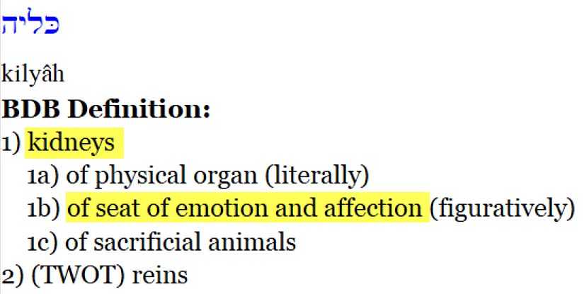
H3629
Brown-Driver-Briggs – Hebrew Definitions
The remaining nine references all use kidneys as a symbol of the inner most being. This is probably so since in dismembering an animal the kidneys are the last organ to be reached. In this usage it is frequently paralleled with heart (as it is at least once in Ugaritic). Jeremiah seems to be emphasizing this innermost idea when he says that the religion of the wicked is superficial, on their lips, but far from their kidneys (Jer_12:2). Five times in Jeremiah and Psalms the importance of inner religion is stressed when it is said that God tries the heart and the kidneys (Jer_11:20). (Theological Wordbook of the Old Testament)

Slide 15
The common idea that the burning either of part or the whole of the sacrifice pointed to its destruction, and symbolized the wrath of God and the punishment due to sin, does not seem to accord with the statements of Scripture. The term used is not that commonly employed for burning, but means ‘causing to smoke,’ and the rite symbolizes partly the entire surrender of the sacrifice, but chiefly its acceptance on the part of God.
The Temple—Its Ministry and Services. Chapt: Sacrifices. Alfred Edersheim

Slide 16
Which Parts of the Sacrifice was burned?
Animals given for the peace, sin, and trespass offerings, as well as those offered for consecration of the priests, were to have the internal fat, the kidneys, and the caul above the liver removed and burned on the altar (Exo_29:13, Exo_29:22; Lev_3:4, Lev_3:10, Lev_3:15; Lev_4:9; Lev_7:4; Lev_8:16, Lev_8:25; Lev_9:10, Lev_9:19).
(Theological Wordbook of the Old Testament)

Slide 17
This explains an important fact about Jesus.
Born with sinful flesh (MGE’s), how could He live a perfect life in childhood?
For thou hast possessed my reins: thou hast covered me in my mother's womb. (Psa 139:13 KJV)

Slide 18
Let this mind be in you, which was also in Christ Jesus: (Php 2:5 KJV)

Slide 19
For if after they have escaped the pollutions of the world through the knowledge of the Lord and Saviour Jesus Christ, they are again entangled therein, and overcome, the latter end is worse with them than the beginning. For it had been better for them not to have known the way of righteousness, than, after they have known it, to turn from the holy commandment delivered unto them. (2Peter 2:20-21 KJV)

Slide 20
When the unclean spirit is gone out of a man, he walketh through dry places, seeking rest; and finding none, he saith, I will return unto my house whence I came out. And when he cometh, he findeth it swept and garnished. Then goeth he, and taketh to him seven other spirits more wicked than himself; and they enter in, and dwell there: and the last state of that man is worse than the first. (Luke 11:24-26 KJV)

Slide 21
And what agreement hath the temple of God with idols? for ye are the temple of the living God; as God hath said, I will dwell in them, and walk in them; and I will be their God, and they shall be my people. (2Co 6:16 KJV)
Jesus answered and said unto him, If a man love me, he will keep my words: and my Father will love him, and we will come unto him, and make our abode with him. (Joh 14:23 KJV)

Slide 22
Gotta Serve Somebody Written by: Bob Dylan
You may be an ambassador to England or France
You may like to gamble, you might like to dance
You may be the heavyweight champion of the world
You may be a socialite with a long string of pearls
But you’re gonna have to serve somebody, yes indeed
You’re gonna have to serve somebody
Well, it may be the devil or it may be the Lord
But you’re gonna have to serve somebody

Slide 23
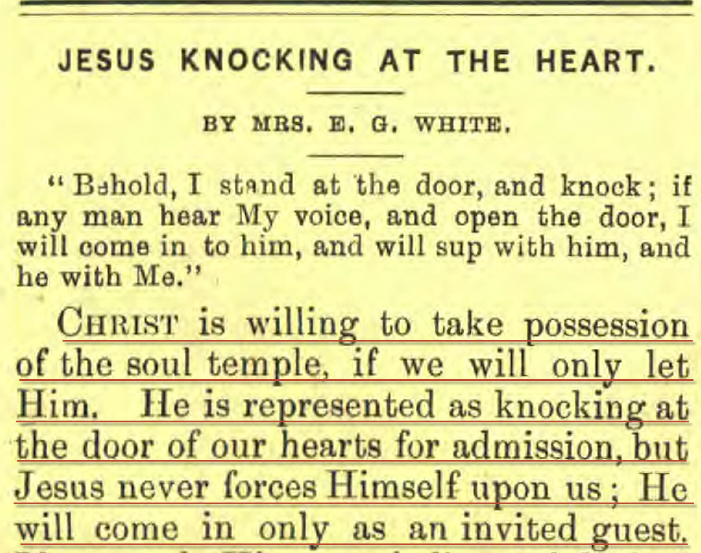
Present Truth, April 24, 1890.

Slide 24
When God thinks for a man it is not like one man’s thinking for and imposing his will on another. There is perfect freedom. The man chooses God’s thoughts, because they are better than his own, and then God thinks in him, the man’s brain being the organ of the Holy Spirit. “For ye have not received the spirit of bondage again to fear” (Rom. 8:15), but God has given us the Spirit “of power and of love and of a sound mind.”(2 Tim. 1:7). Only by the Spirit of God can anybody rightly know anything.(1 Cor. 2:12). When men submit to be the temples of God, then is God's will done on earth even as it is done in heaven.
(E. J. Waggoner. The Sanctuary of God)

Slide 25
Let this mind be in you, which was also in Christ Jesus: (Php 2:5 KJV)

Slide 26
But we preach Christ crucified, unto the Jews a stumblingblock, and unto the Greeks foolishness; (1Cor 1:23 KJV)
Christ crucified — The Greek expresses not the mere fact of His crucifixion, but the permanent character acquired by the transaction –
Jamieson – Fausset – Brown Commentary

Slide 27
Gotta Serve Somebody - cont
You may be a preacher with your spiritual pride You may be a city councilman taking bribes on the side You may be workin’ in a barbershop, you may know how to cut hair You may be somebody’s mistress, may be somebody’s heir But you’re gonna have to serve somebody, yes indeed You’re gonna have to serve somebody Well, it may be the devil or it may be the Lord But you’re gonna have to serve somebody

